Slide 1
Nuclear and Radiological Security Challenges: A Case of Eurasia
Margarita Sevcik
Center for Nonproliferation Studies
Monterey Institute of International Studies
2011-2012 Critical Issues Forum (CIF) Teacher Development Workshop
2 December 2011

Slide 2
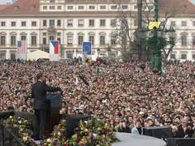
“…[We] must ensure that terrorists never acquire a nuclear weapon. This is the most immediate and extreme threat to global security. One terrorist with one nuclear weapon could unleash massive destruction. Al Qaeda has said it seeks a bomb and that it would have no problem with using it. And we know that there is unsecured nuclear material across the globe.” — U.S. President Barack Obama speaking in Prague on 5 April, 2009

Slide 3
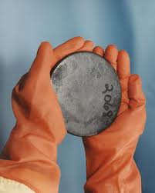
Nuclear Material
Uranium (U), plutonium (Pu)
Fissile materials:U-235, Pu-239
dual-use purpose (military and civilian application)
Weapons-grade
Highly Enriched Uranium with U-235 over 90%
Pu-239 – 93%
Weapons-useable
HEU below 90%
U-233
Reactor-grade Pu
Notes:
Fissile materials are those which are composed of atoms that can be split by neutrons in a self-sustaining chain-reaction to release energy, and include plutonium-239 and uranium-235
Plutonium separated from the spent fuel of commercial nuclear power reactors

Slide 4
How much material is needed to create a nuclear device?
Official IAEA significant quantity: 25 kg of U-235 or 8 kg of Pu239
Other estimates: 12-15 to 25 kilograms of highly enriched uranium (HEU) or 4 to 8 kilograms of weapons-usable plutonium

Slide 5
Radioactive Sources
Reactor-produced radioisotopes pose the greatest security risks: Cobalt-60, Cesium-137, Iridium- 192, Strontium-90, Americium-241, Californium-252, Plutonium-238.
Radiological dispersal device –”any device, including any weapon or equipment, other than a nuclear explosive device, specifically designated to employ radioactive material by disseminating it to cause destruction, damage, or injury by means of the radiation produced by the decay of such material” (DOD definition).
Notes:
Radioactive sources are made from radiisotopes, which are unstable isotopes which emit radiation and decay to either other unstable or stable isotopes

Slide 6
Security Challenge I: Significant Amounts of Nuclear Material in Eurasia
Soviet nuclear legacy:
The former USSR produced up to 950 tons of HEU and 100-150 tons of Pu for weapons purposes;
Nuclear weapons and material dispersed throughout the Newly Independent States;
Soviet inventory system of nuclear material (material protection, control and accounting system) focused on production targets and not on security. Civilian research facilities with weapons-grade materials had minimum security;
Potential of insider theft at nuclear facility
Illicit trafficking of nuclear material

Slide 7
Countries of Particular Concern
Russia – the sole nuclear successor state of the former Soviet Union;
Ukraine, Belarus and Kazakhstan – sizeable nuclear weapons infrastructures on their territories after the break up of the Soviet Union;
Other former Soviet republics hosting nuclear research or uranium mining and processing facilities
http://www.nti.org/e_research/gmap/

Slide 8
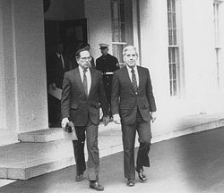
US-NIS Efforts to Address Soviet Nuclear Legacy
Cooperative Threat Reduction
Program (The Nunn-Lugar Program)
Dismantle FSU WMD infrastructure
Consolidate and secure FSU WMD and related technology and materials (Project Saphire – removal of 600 kg of HEU from Kazakhstan)
Support conversion of defense enterprises and prevent a brain drain
CTR provided funding and expertise for Russia, Ukraine, Georgia, Azerbaijan, Belarus, Uzbekistan, and Kazakhstan

Slide 9
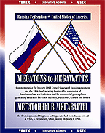
Russian HEU conversion
efforts
“Megatons to Megawatts" program (HEU-LEU deal) – conversion of Russia's HEU from nuclear weapons into LEU for U.S. nuclear power reactors. 10% of electricity used in the United States comes from dismantled Russian nuclear bombs.
Notes:
Under the agreement that the countries signed in 1993, Moscow made a commitment to eliminate 500 metric tons of HEU--probably more than one-third of the total HEU stock that the Soviet Union produced during the Cold War. About 340 metric tons of HEU has already been converted into LEU. Russian facilities involved in the conversion process include Siberian Chemical Enterprise (SChE) (Seversk), Mayak Production Association (MPA) near Ozersk,

Slide 10
Reducing Nuclear Material Threat in Eurasia
Global Threat Reduction Initiative (GTRI), Office of Defense Nuclear Nonproliferation, National Nuclear Security Administration:
- Conversion of research reactors from the use of HEU to LEU: Two reactors in Uzbekistan and Ukraine (2008);
- Shipment of HEU fresh fuel to Russia from Uzbekistan (2004), Latvia (2005) and 2 facilities from Ukraine (Kiev and Sevastopol, 2010);
- HEU spent fuel was shipped to Russia from Uzbekistan (2006), Latvia (2008), and Kazakhstan (2009).
Notes:
Since 2002, Russia has been consolidating fresh and spent Soviet-origin HEU fuel from foreign countries under the Russian Research Reactor Fuel Return Program (RRRFR). A table listing these shipments can be found in the Past and Current Efforts to Reduce Civilian HEU Use file.
A formal agreement regarding fuel removal was concluded between the U.S. and Russian governments and signed in May 2004. The Agreement covers major activities related to providing assistance to return Soviet-origin nuclear fuel from 13 countries to Russia. As of July 2011, fresh (unused) HEU fuel had already been removed from Serbia, Bulgaria, Romania, Libya, the Czech Republic, Uzbekistan, Latvia, Vietnam, Germany and Kazakhstan. Fresh HEU fuel located at three sites in Ukraine has also been partly removed, with a commitment for all of it to be returned to Russia by the time of the 2012 Nuclear Security Summit. [30]
Spent fuel has already been removed from research reactors in Bulgaria, the Czech Republic, Hungary, Kazakhstan, Latvia, and Uzbekistan. The irradiated fuel is reprocessed at the Mayak Production Association.

Slide 11
Current Challenges: HEU Minimization at Russian Reactors
50 research reactors, pulsed reactors and critical assemblies using HEU, and 9 HEU-fueled icebreakers;
2010 - joint study with U.S. into the feasibility of converting six Russian research reactors from HEU to LEU-based reactor fuels.
However, Russia made no declaration of reduced HEU usage or consolidated stockpiles, nor had they committed to converting any of its domestic HEU-fueled reactors

Slide 12
Nuclear Material in Russia: Current Situation
Russia holds the largest stock of HEU (current stock ~770 metric tons of grade-equivalent
Russia ceased production of HEU for military purposes in 1989, but uses HEU for civilian purposes
Only one site has been reportedly cleaned out of all HEU materials
Russia ceased its production of weapons-grade plutonium in April 2010. Current estimates of Pu in Russia vary from 128 to 145 metric tons.
RUSSIA HAS SIGNINIFICANT QUANTITIES OF WEAPONS-GRADE HEU AND PU, WHICH POSE A MAJOR NUCLEAR SECURITY THREAT IN EURASIA
*The International Panel on Fissile Materials
Notes:
The majority of Russian HEU is in the military stockpile, either in weapons or in reserve holdings, though the Soviet government ceased production of HEU for weapons in 1989.[9] Military use of HEU also includes fueling nuclear submarines.
Russia still uses HEU for civilian applications, including the fueling of research and test reactors, critical assemblies, fast reactors, and icebreakers, as well as for the production of medical isotopes.
with the assistance of the U.S. Department of Energy's Material Consolidation and Conversion program, all HEU (65 kg U-235 contained in 181 kg of uranium), was consolidated from the Krylov Shipbuilding Research Institute to the All-Russian Scientific Research Institute of Atomic Reactors (NIIAR) in Dimitrovgrad by March 2006.[28]

Slide 13
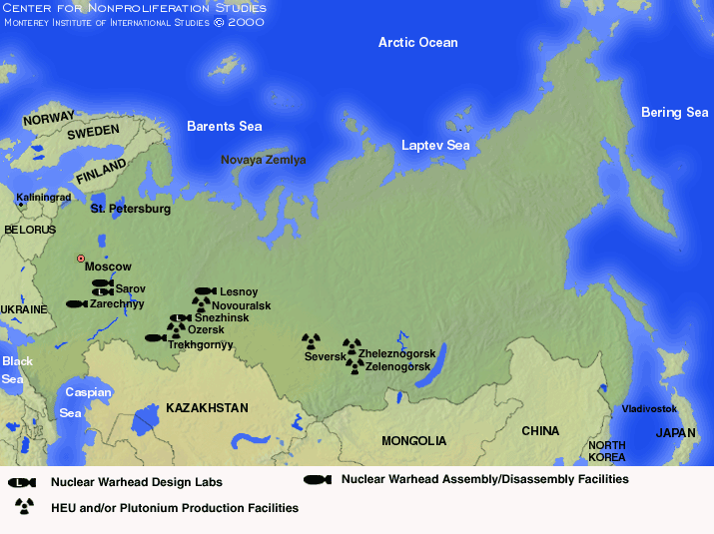

Slide 14
Nuclear Material in Eurasia
Remaining HEU and Pu (in spent fuel) in other former Soviet republics, including Belarus, Ukraine, Kazakhstan (significant amounts of HEU and PU from decommissioned BN-350 reactor in Aktau was moved to the long-term depository at Semipalatinsk Test Site)
Kazakhstan converted one of its reactors to the use of LEU in August 2011, but two other research reactors still operate on HEU fuel
Ukraine has about 68 kg of HEU at the Kharkiv Institute of Physics and Technology; roughly 13 kg at the Institute for Nuclear Research in Kiev; and about 6 kg at the Sevastopol Naval Research Institute. Ukraine agreed to eliminate its HEU stock by 2012* and convert its remaining nuclear reactors;
Belarus has about 170 kg of fresh HEU fuel, of which approximately 40 kg (88 pounds) is enriched as high as 90% U-235.** In 2010, Belarus announced its decision to return the HEU to Russia. There are efforts to convert one of its facilities to the use of LEU.
ACCELERATED CONSOLIDATION OF NUCLEAR MATERIAL AND CONVERSION OF REACTORS TO THE USE OF LEU WILL SIGNIFICANTLY REDUCE NUCLEAR SECURITY THREATS IN EURASIA
*Martin Matishak, “Ukraine Agrees to Eliminate Highly Enriched Uranium Stock by 2012,” NTI: Global Security, April 13, 2010.
** William Potter, “Belarus Agrees to Remove All HEU,” CNS Feature Stories, December 1, 2010, http://cns.miis.edu/stories/101201_belarus_heu.htm

Slide 15
Security Challenge II: Radioactive Sources
Orphan sources – radioactive sources outside of institutional control because they have been lost, abandoned, or stolen.*
Soviet-era Gamma Kolos program - production of truck-mounted seed irradiators (Cs-137) that were designed to expose plants to radiation and measure the effects;
Radioisotope Thermoelectric Generators (RTG) containing strontium-90;
Radioactive sources in military, commercial or medical equipment, metal scrap.
*Charles Ferguson, Commercial Radioative Sources: Surveying the Security Risks.

Slide 16
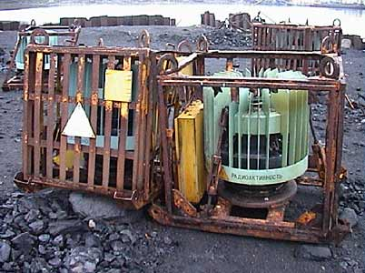
Security Risks Posed by RTGs in Eurasia
RTGs– are nuclear powered batteries with St-90 core that convert thermal energy from the decay of strontium elements into electricity. They are highly radioactive and can cause serious illness of death.
There are about 1000 RTGs in Russia;
Concern: while most of RTGs were recovered on the territories of the former Soviet republics, whereabouts of some of these generators are still unknown (Kyrgyzstan, Tajikistan, Western Georgia)
Abandoned RTGs on the Kola Peninsula. Source: Bellona
Notes:
Hundreds were positioned in Russia along coasts lines and remote areas in other former Soviet republics o power lighthouses, navigation beacons, and meteorological data collection installations, but that was decades ago.

Slide 17
Security Challenge III: Illicit Trafficking in Nuclear and Radioactive Material
Several cases involving Eurasian countries and/or material of Soviet/Russian origin;
Established drug-trafficking routes throughout Eurasia;
Increased activities of pan-Islamic radical groups;
Insecure borders, especially in the conflict zones.

Slide 20
Recent incidents
2003, 2006 & 2010 HEU seizures in Georgia
2011 seizure in Moldova
Detections of radioactive sources in metal scrap shipped from Central Asia

Slide 21
Cooperative efforts to enhance security of nuclear and radioactive materials
Nuclear Smuggling Outreach Initiative, U.S State Department:
- Bilateral partners: Ukraine, Kazakhstan, Georgia, Armenia, Moldova, Tajikistan, Azerbaijan, Uzbekistan
Main areas of cooperation:
- Improving security at facilities with high-activity radiological sources;
- Improving accounting and control of radioactive sources;
- Securing orphaned and unregistered sources;
- Improving radiation detection capabilities at ports of entry and border
security;
- Improving nuclear forensics capabilities;
- Anti-corruption training assistance

Slide 22
Margarita Sevcik
Center for Nonproliferation Studies
Monterey Institute of International Studies
msevcik@miis.edu

