Slide 1
WMD Overview
Presentation to the Visiting Fellows
Bryan Lee
January 31, 2013

Slide 2
Objectives
Define Weapons of Mass Destruction (WMD) and different categories of Chemical, Biological, Radiological and Nuclear weapons
Identify the characteristics of each type of WMD as well as potential delivery mechanisms
Describe the proliferation pathway

Slide 3
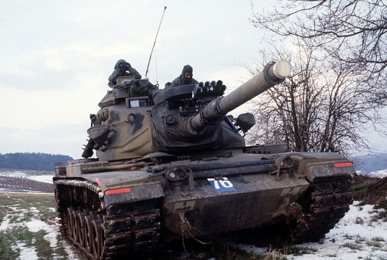
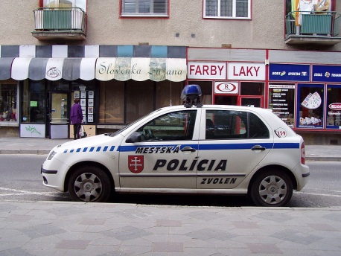
WMD Definition
Military: Chemical, biological, radiological, or nuclear weapons capable of a high order of destruction or causing mass casualties
Legal: Any weapon that is designed or intended to cause death or serious bodily injury through the release, dissemination, or impact of toxic or poisonous chemicals, or their precursors; any weapon involving a biological agent, toxin, or vector; any weapon that is designed to release radiation or radioactivity at a level dangerous to human life
Procedural: …”all chemical and biological weapons and all stocks of agents and all related subsystems and components….”
Notes:
Military: US Joint Staff Definition
Legal: 18 USC § 2332a - Use of weapons of mass destruction
Procedural: UNSCR 687 (Iraq)

Slide 4
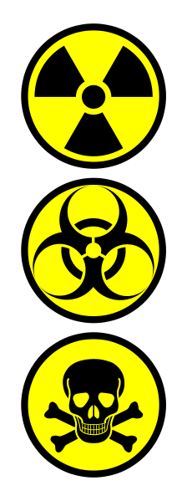
Types of WMD
Nuclear/Radiological
Biological
Missiles
Chemical
Wikimedia Commons and User:Andux

Slide 5
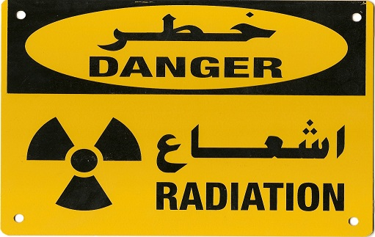
Nuclear
Nuclear materials
Nuclear weapons
Radiological materials
Image--http://www.spss.com.sa/

Slide 6
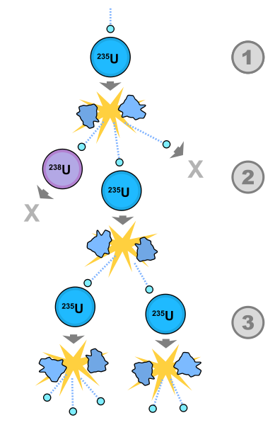
Nuclear Materials
Uranium
238 U
235 U
HEU
LEU
Plutonium
Byproduct of Uranium decay
Notes:
A uranium-235 atom absorbs a neutron, and fissions into two new atoms (fission fragments), releasing three new neutrons and some binding energy.
One of those neutrons is absorbed by an atom of uranium-238, and does not continue the reaction. Another neutron is simply lost and does not collide with anything, also not continuing the reaction. However one neutron does collide with an atom of uranium-235, which then fissions and releases two neutrons and some binding energy.
Both of those neutrons collide with uranium-235 atoms, each of which fission and release between one and three neutrons, and so on.

Slide 7
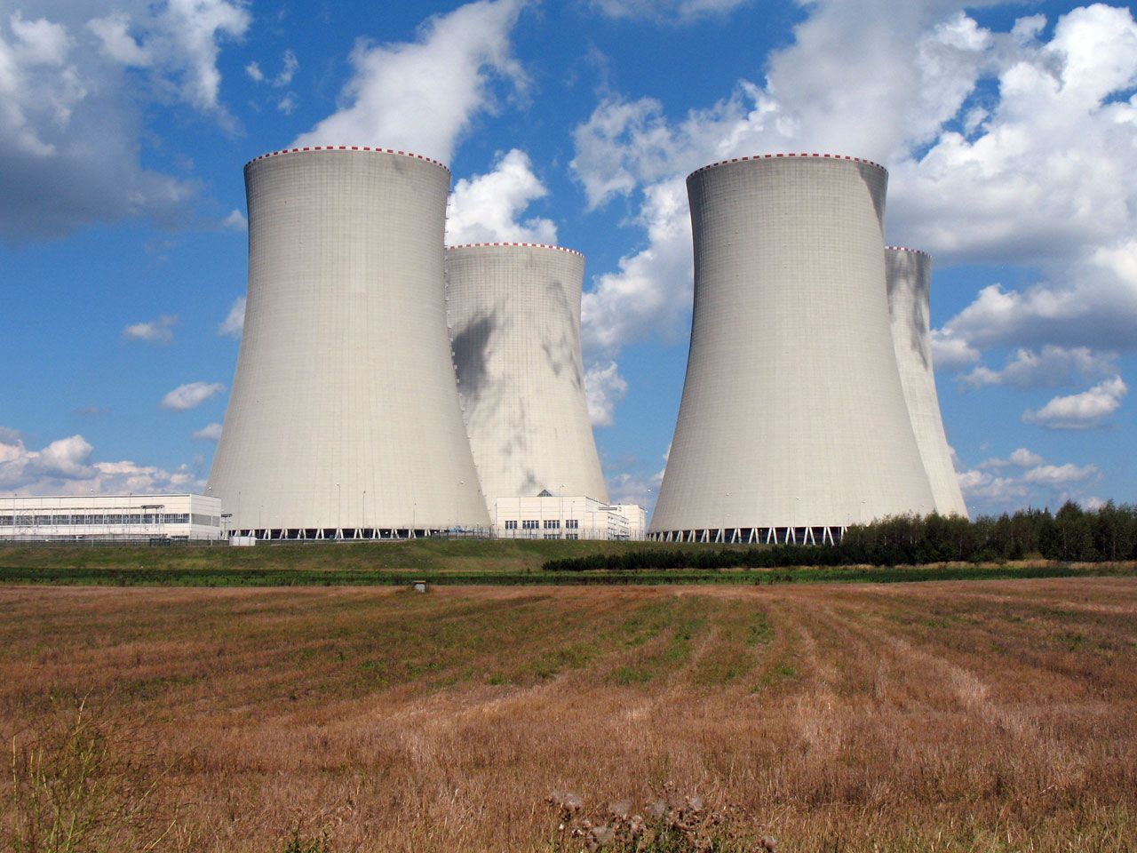
Nuclear Materials

Slide 8
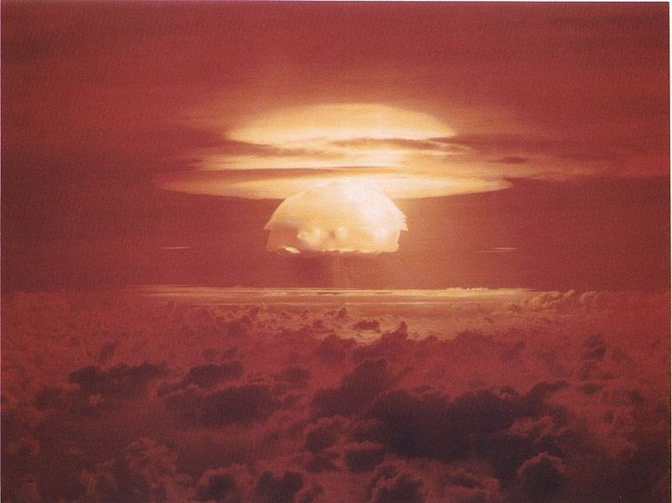
Nuclear Materials

Slide 9
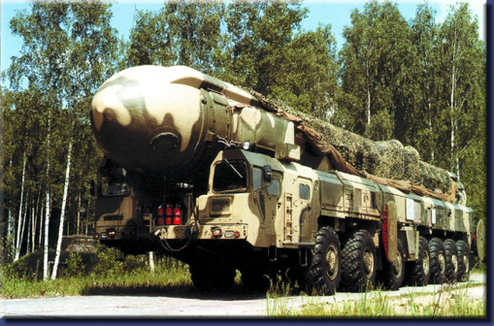
Nuclear Weapons
Approximately 20,000 in world inventories
Nation-State owned and controlled
Subject to much international scrutiny
Source: http://www.missilethreat.com/picturesindex/pageID.280/default.asp
Notes:
20,500 warheads according to the Federation of American Scientists.

Slide 10
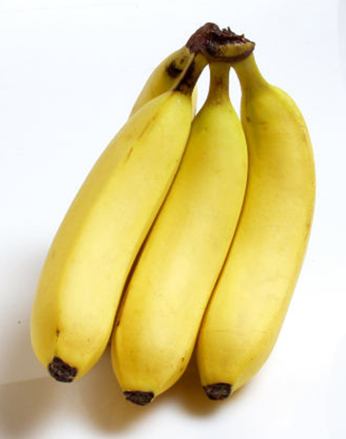
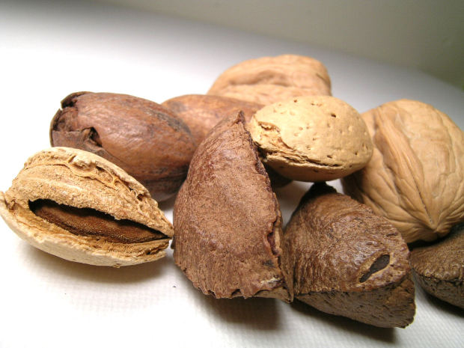
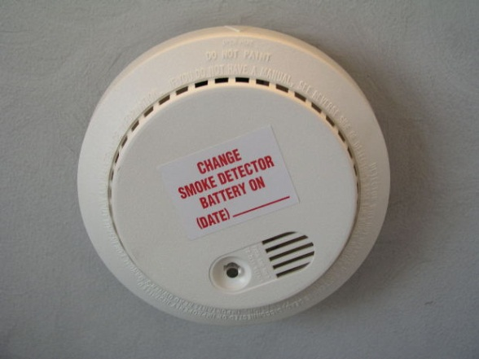
Radiological Materials
Radioactive
Substances which emit energy in the form of ionizing particles
Notes:
Bananas: Potassium 40 (beta)
Brazil Nuts: Radium 226 and 228 (alpha; beta)
Smoke detector: Americium 241 (alpha)

Slide 11
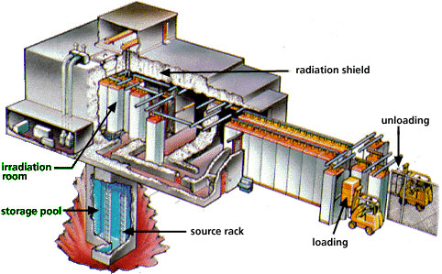
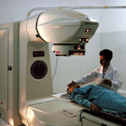
Radiological Materials
Notes:
Food irradiation & teletherapy: Cobalt 60 (beta and lots of gamma)
Thailand 2000 scrap metal case study
In 2000, a disused radiotherapy head containing a 60Co source was stored at an unsecured location in Bangkok, Thailand and then accidentally was sold to scrap collectors. Unaware of the dangers, a junkyard employee dismantled the head and extracted the source, which remained unprotected for a period of days at the junkyard. Ten people, including the scrap collectors and workers at the junkyard, were exposed to high levels of radiation and became ill. Three of the junkyard workers subsequently died as a result of their exposure, which was estimated to be over 6 Gy. The source was safely recovered by the Thai authorities.

Slide 12
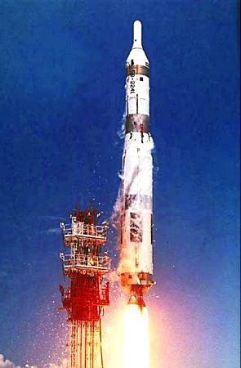
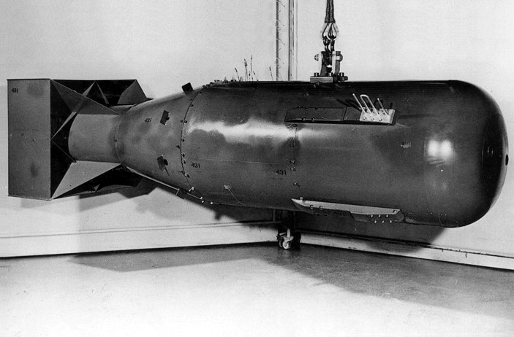
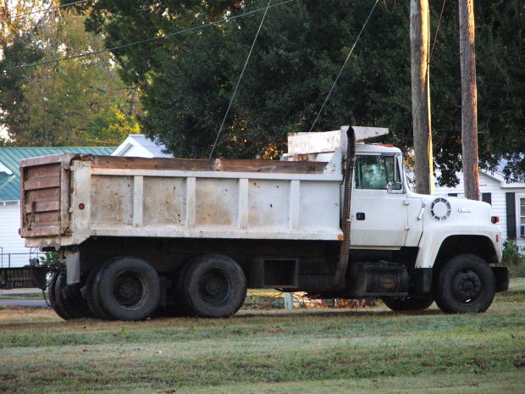
Nuclear delivery options

Slide 13
Nuclear delivery options?

Slide 14
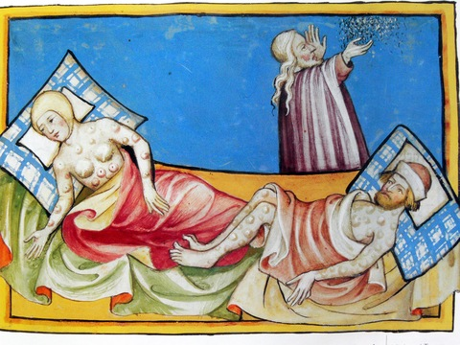
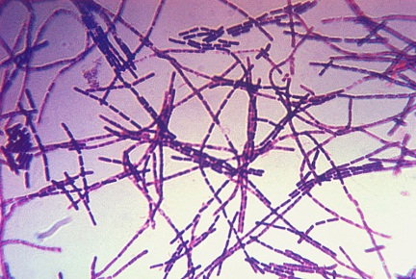
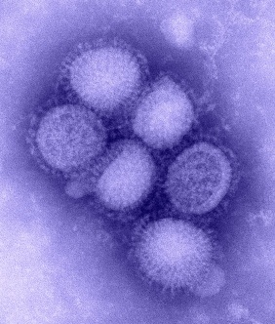
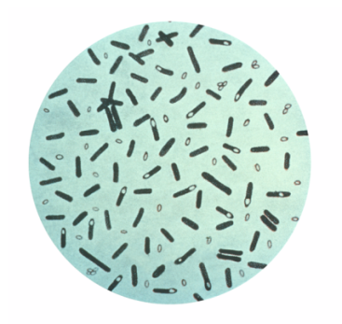
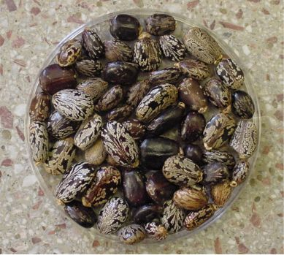
Biological Agents
Types
Pathogens
Bacteria
Viruses
Toxins
Bacillus Anthracis
H1N1
Clostridium Botulinum
Castor Beans
Notes:
The 1984 Rajneeshee bioterror attack was the food poisoning of 751 individuals in The Dalles, Oregon, United States, through the deliberate contamination of salad bars at ten local restaurants with salmonella. A leading group of followers of Bhagwan Shree Rajneesh (later known as Osho) had hoped to incapacitate the voting population of the city so that their own candidates would win the 1984 Wasco County elections.^{[2]} The incident was the first and single largest bioterrorist attack in United States history.^{[3][4]} The attack is one of only two confirmed terrorist uses of biological weapons to harm humans since 1945.^{[5]}
Having previously gained political control of Antelope, Oregon, Rajneesh's followers based in nearby Rajneeshpuram, Oregon, sought election to two of the three seats on the Wasco County Circuit Court that were up for election in November 1984. Fearing they would not gain enough votes, Rajneeshpuram officials decided to incapacitate voters in The Dalles, the largest population center in Wasco County. The chosen biological agent was Salmonella enterica Typhimurium, which was first delivered through glasses of water to two County Commissioners and then, on a larger scale, at salad bars and in salad dressing.
751 people contracted salmonellosis as a result of the attack; 45 of whom were hospitalized. There were no fatalities
C. Botulinum was attempted by Aum Shinrikyo before moving to chemical weapons.

Slide 15
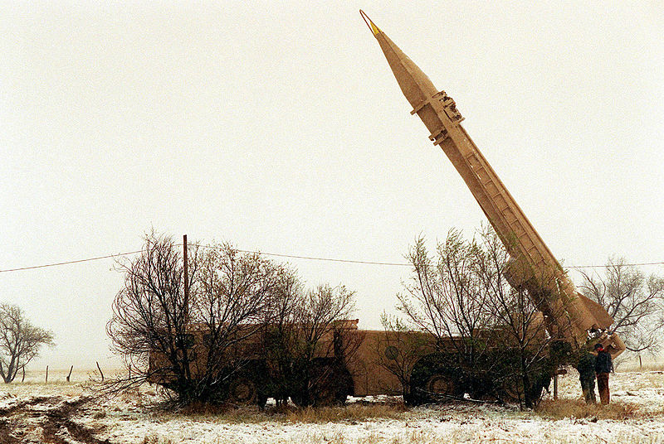
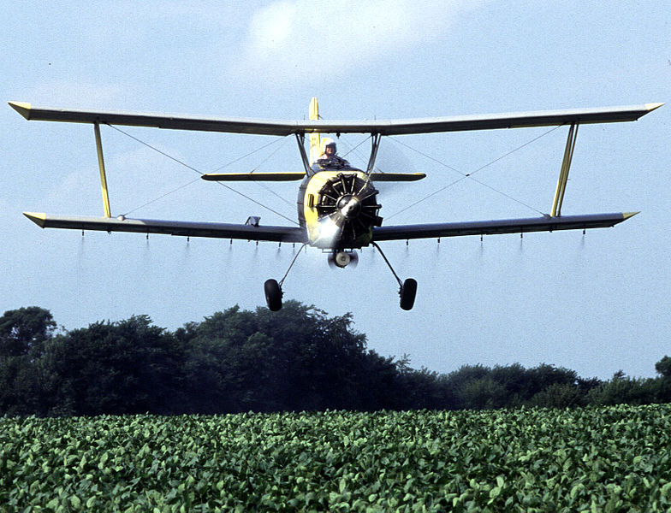
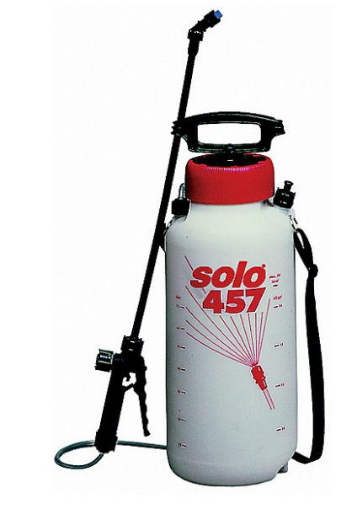
Biological delivery options
Notes:
Umbrella assassination
Agents of the Bulgarian secret police (Darzhavna Sigurnost; Bulgarian: Държавна сигурност, abbreviated ДС), assisted by the KGB, had previously made two failed attempts to kill Markov before a third attempt succeeded. On September 7, 1978 (the 67th birthday of Todor Zhivkov), Markov walked across Waterloo Bridge spanning the River Thames, and waited at a bus stop to take a bus to his job at the BBC. He felt a slight sharp pain, as a bug bite or sting, on the back of his right thigh. He looked behind him and saw a man picking up an umbrella off the ground. The man hurriedly crossed to the other side of the street and got in a taxi which then drove away. The event is recalled as the "Umbrella Murder" with the assassin claimed to be Francesco Gullino, codenamed "Piccadilly".
When he arrived at work at the BBC World Service offices, Markov noticed a small red pimple had formed at the site of the sting he had felt earlier and the pain had not lessened or stopped. He told at least one of his colleagues at the BBC about this incident. That evening he developed a fever and was admitted to a hospital where he died three days later, on September 11, 1978, at the age of 49. The cause of death was poisoning from a ricin-filled pellet.^{[3][4][5]}

Slide 16
Chemical
Types of agents
Chemical weapons
Blood
Blister
Choking
Nerve
Toxic industrial chemicals
Notes:
Nerve Agents
•Health Effects ◦Physostigmine cholinesterase inhibitors (reversible)
◦Organophosphorus cholinesterase inhibitors (irreversible)
◦Disable enzymes responsible for transmitting nerve impulses.
◦Initial effects of organophosphorus agents occur within 1-10 minutes of exposure
◦Death
■Within 15 minutes for Tabun, Sarin, and Soman
■From 4-42 hours for VX.
•Agents Include ◦Tabun (NATO military designation, GA)
◦Sarin (NATO military designation, GB)
◦Soman (NATO military designation, GD)
◦GF (Cyclohexyl methylphosphonofluoridate)
◦VX (Methylphosphonothioic acid S-(2-(bis(1-methylethyl)amino)ethyl) O-ethyl ester)
◦GE (Phosphonofluoridic acid, ethyl-, isopropyl ester)
◦VE (Phosphonothioic acid, ethyl-, S-(2-(diethylamino)ethyl) O-ethyl ester)
◦VG (Amiton)
◦VM (Phosphonothioic acid, methyl-, S-(2-(diethylamino)ethyl) O-ethyl ester)
Blister/Vesicant Agents
•Health Effects ◦Vesicants
■Skin blisters
■Damage eyes, mucous membranes, respiratory tract, and internal organs
■Initial effects rapid
◦Mustard agents
■Destroy different substances within cells of living tissue
■Initial effects occur 12 to 24 hours after exposure.
◦Symptoms variable
◦Acute mortality low
◦Death can occur from complications after lung injury.
•Agents Include ◦Lewisite (L)
◦Mustard-Lewisite (HL)
◦Nitrogen mustards (HN-1, HN-2, HN-3)
◦Phosgene oxime (CX)
◦Sulfur mustards ( H, HD, HT)
Blood Agents-- They inhibit the ability of blood cells to utilise and transfer oxygen. Thus, blood agents are poisons that effectively cause the body to suffocate.
•Health Effects ◦Highly volatile
◦Rapidly acting
◦seizures
◦respiratory failure
◦cardiac arrest
•Agents Include ◦Cyanogen chloride (CK)
◦Hydrogen cyanide (AC)
Pulmonary Agents
•Health Effects ◦Liquids dispersed in gas form
◦Damage the respiratory tract and cause severe pulmonary edema in about four hours, leading to eventual death. Effects are variable
◦Rapid or delayed depending on the specific agent.
•Agents Include ◦Chlorine
◦Chloropicrin (PS)
◦Diphosgene (DP)
◦Phosgene (CG)

Slide 17
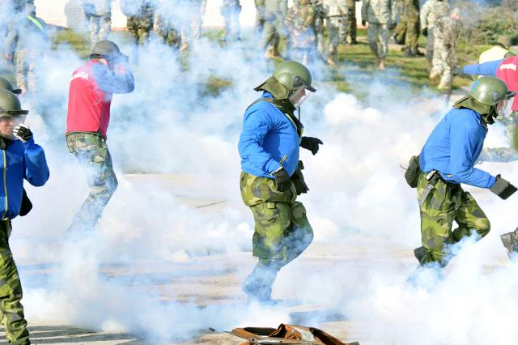
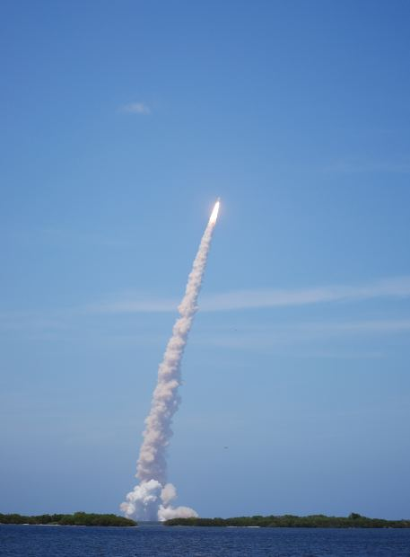
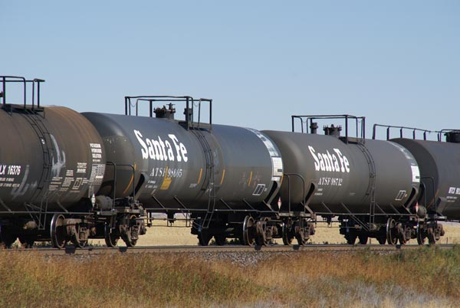
Chemical delivery options
Freefoto.com
Notes:
Mubtakkar
Suskind details the discovery and potential of an al-Mubtakkar hydrogen cyanide dispersal device in sobering detail. He writes:
"[A joint Saudi-US counterterrorist unit] found it [in a jihadist apartment in Saudi Arabia]: plans for construction of a device called a mubtakkar. It is a fearful thing, and quite real....a delivery system for a widely available combination of chemicals--sodium cyanide, which is used as rat poison and metal cleanser, and hydrogen, which is everywhere. The combination of the two creates hydrogen cyanide, a colorless, highly volatile liquid that is soluble and stable in water. It has a faint odor, like peach kernels or bitter almonds. When it is turned into gas and inhaled, it is lethal. For years, figuring out how to deliver this combination of chemicals as a gas has been something of a holy grail for terrorists....Mubtakkar means "invention" in Arabic, "the initiative" in Farsi. The device is a bit of both. It's a canister with two interior containers: sodium cyanide is in one; a hydrogen product, like hydrochloric acid, in the other; and a fuse breaks the seal between them. The fuse can be activated remotely--as bombs are triggered by cell phones--breaking the seal, creating the gas, which is then released. Hydrogen cyanide gas is a blood agent, which means it poisons cells by preventing them from being able to utilize oxygen carried in the blood.

Slide 18
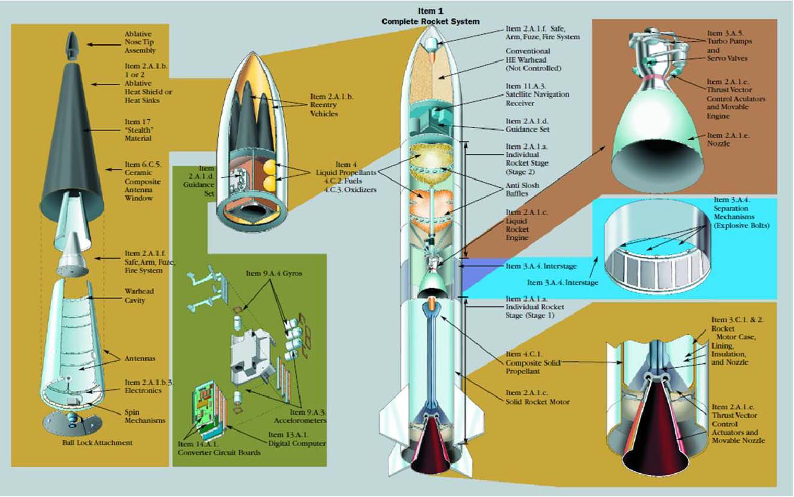
Missile Systems

Slide 19
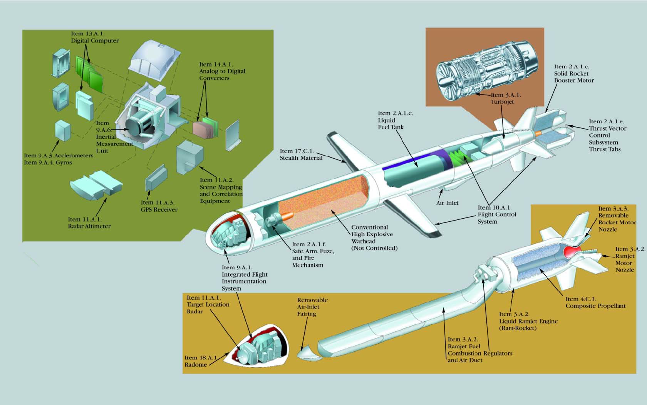
Missile Systems

Slide 20
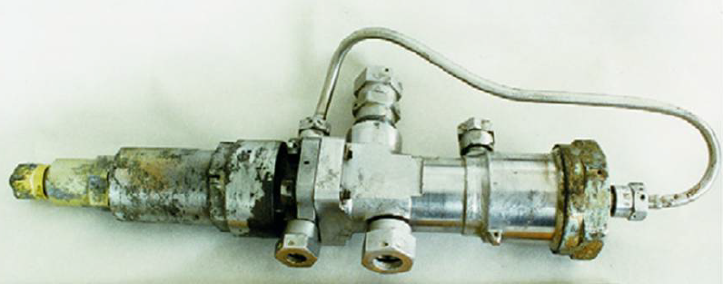
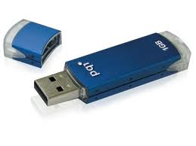
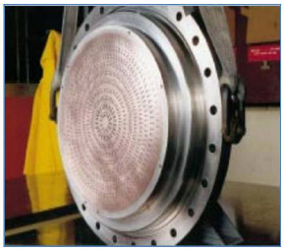
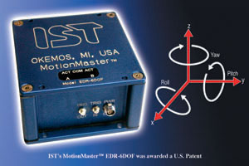
Missile Systems
Notes:
Accelerometer, IST corporation
Liquid propellant injector plate, Boeing
SCUD missile servo valve

Slide 21
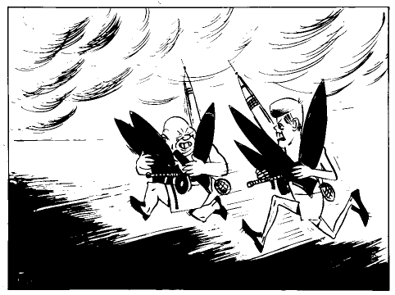
Classic Proliferation
What do we mean?
Who cares?
Treaties
Stability
Historical examples
South Africa
North Korea
Notes:
1961 Cartoon
South Africa joined NPT in 1991.

Slide 22
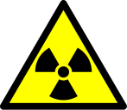
Today’s Proliferation
An introduction to dual use
The proliferation pathway
The global market and illicit supply networks

Slide 23
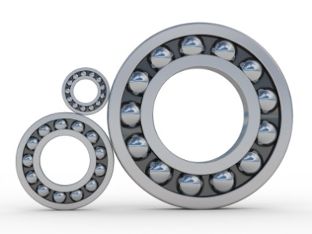
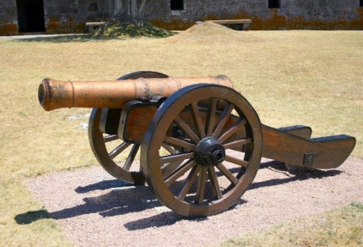
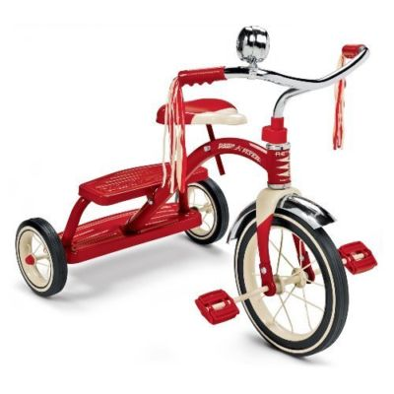
What is Dual Use?
Pure Military
Pure Civilian
Pure Trouble

Slide 24
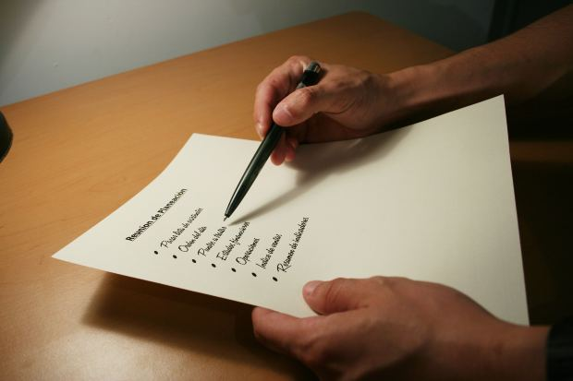
How Can You Tell?
Export Control Lists
Nuclear Suppliers Group
Australia Group
Missile Technology Control Regime
Wassenaar Arrangement
Notes:
Ask someone: 1540, PSI

Slide 25
The Proliferation Pathway
Proliferation Phases
Material, Technology, Knowledge Developed
Seller Obtains Commodity
Material, Technology, Knowledge Transmitted via Middlemen
Buyer Obtains Commodity
Assembly
Release
Involved Parties
Technicians, Scientists, Security, Management
Technicians, Scientists, Security, Management
Smugglers, Brokers, Trans-shippers, Port Authorities
State or Non-State Actors
Technicians, Scientists, Security, Management
State or Non-State Actors
Notes:
The problem is WMD doesn’t usually come preassembled.
Pathway model comes from Andrew Dolan and the ICP Program

Slide 26
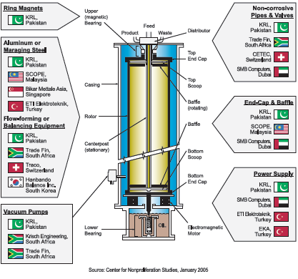
The Global Market Libyan Centrifuge Component Suppliers

Slide 27
Summary
The definition of WMD depends on context
Military
Legal
Procedural
There are three basic categories of WMD
Missile technology is also a concern
Proliferation follows a defined path, and can be hindered with the right tools

