Slide 1
Nuclear Safety and Security: Nuclear Nonproliferation and Disarmament
The connections

Slide 2
Safety & Security – what is the difference?
Security is protection against deliberate incidents
Safety is protection against unintended incidents

Slide 3
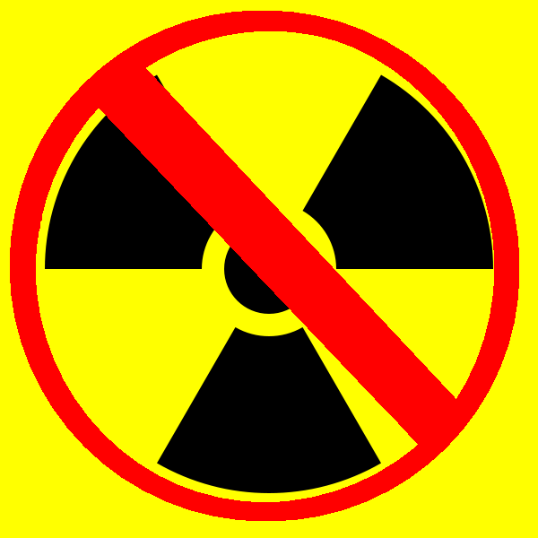
Nonproliferation & Disarmament- what is the difference?
Nonproliferation is aimed at preventing the spread of nuclear weapons beyond those countries that already have them
Disarmament is aimed at reducing and eventually eliminating nuclear weapons worldwide.

Slide 4
Nuclear safety
In nuclear fuel cycle: mining, fuel fabrication, reprocessing…..
At nuclear power reactors – civil and military
In the medical industry
In transport sector
At nuclear weapons facilities and on nuclear weapons platforms – submarines, aircraft, ships….

Slide 5
Threats to safety
Accidents at plants
Leakage
Earthquakes, Tsunamis, Floods, Droughts…
Accidents due to human error
Accidents due to machine/computer error
Accidental delivery and detonation of weapons

Slide 6
Nuclear reactor accidents

Slide 7
The IAEA safety action plan
http://www.iaea.org/newscenter/focus/actionplan/

Slide 8
I-131 release in Hungary, Nov 2011

Slide 9
August 29–30, 2007. 6 cruise missiles, each W80-1 variable yield nuclear warhead, mistakenly loaded B-52H heavy bomber at Minot and transported to Barksdale

Slide 10
Safety issues and nonproliferation
Uncertainties and low confidence in capabilities to manage risks and accidents reduces nuclear industry in a number of countries
Reduces capabilities to develop nuclear weapons
Public connects nuclear energy and nuclear weapons
Enhances nonproliferation efforts

Slide 11
Safety and disarmament
Safety concerns may reduce desire for nuclear technology
Safety concerns over nuclear warhead designs could increase calls for nuclear testing – unless the warhead is removed from stockpile

Slide 12
Nuclear security
In nuclear fuel cycle: mining, fuel fabrication, reprocessing…..
At nuclear power reactors – civil and military
In the medical industry
In transport sector
At nuclear weapons facilities and on nuclear weapons platforms – submarines, aircraft, ships….
Cyber security issues

Slide 13
Threats to security
Terrorist attacks at plants, in transit..
Sabotage (from outside or within)
Theft of nuclear material
Smuggling of nuclear material
Cyber attacks
Dirty bomb (RDD) use
Deliberate detonation
Provocation

Slide 14
Isfahan Nov 2011
Isfahan

Slide 15
N
Nuclear materials smuggling

Slide 16
A Q Khan

Slide 18
Security issues and nonproliferation
Lack of security facilitates theft and smuggling proliferation
Sabotage could increase determination or could lead to decision to step away from nuclear weapons
Terrorism increases feelings of insecurity which can lead to calls for increased arms and retaliatory threats.

Slide 19
Nuclear security and disarmament
Poor nuclear security reduces confidence in capabilities to secure nuclear materials during disarmament
Low security is not a sound basis for transparency and verification for nuclear disarmament

Slide 20
International Measures and Agreements
2005 International Convention for the Suppression of Acts of Nuclear Terrorism
1987 Convention on the Physical Protection of Nuclear Materials (CPPNM) and Amendment (2005)
UN Security Council Resolution 1540
IAEA INFCIRC 225 Rev. 5 (physical protection against theft)
2006 Global Initiative to Combat Nuclear Terrorism
2002 G-8 Global Partnership Against the Spread of Materials and Materials of Mass Destruction

Slide 21
Nuclear Security Summit 2010
Proposed in President Obama’s Prague Speech April 2009
2010 Washington DC
Largest gathering of Heads of State and Government hosted by U.S. President since 1945
47countries invited
Each brought a “house gift”
India, Israel and Pakistan all participated and all three were represented by their Prime Ministers.
Secure all fissile material by 2014

Slide 22
Work Plan of 2010 NS Summit
Universality & effective implementation of International Convention for the Suppression of Acts of Nuclear Terrorism, Convention on the Physical Protection of Nuclear Material & United Nations Security Council Resolution 1540
Work with IAEA on range of nuclear security agreements
HEU minimization – switch to LEU and other proliferation-resistant technologies/fuels
Establish/maintain robust domestic regulatory capacities & penalties to promote strong nuclear security culture – capacity-building & training
Cooperation re forensics, customs and law enforcement bodies to prevent illicit nuclear trafficking &nuclear terrorism

Slide 23
Nuclear Security Summit 2012
Will address Security and Safety
Prior to Summit: two symposia:
Nuclear Industry Summit - 200 representatives from the nuclear industry will discuss ways for the private sector to assume a stronger role in promoting nuclear security and safety;
Nuclear Security Symposium - 200 high-level representatives from NGOs, nuclear research institutes, and nuclear security experts who will discuss developments in nuclear security and technologies to combat nuclear terrorism.

