Slide 1
International Nuclear Safeguards
Fred Wehling
Center for Nonproliferation Studies
Monterey Institute
of International Studies
Thanks to:
Charles Ferguson
NNSA NA-243
INMM Technical Division
IAEA Public Information Office

Slide 2
Presentation Outline
Definition and Objectives of Safeguards
Safeguards Agreements
Safeguards Approaches, Practices, and Technology

Slide 3

Definition and Objectives
“Effective IAEA safeguards remains the cornerstone of the world’s nuclear non-proliferation regime aimed at stemming the spread of nuclear weapons and moving towards nuclear disarmament.”
Olli Heinnonen
Director of Safeguards

Slide 4
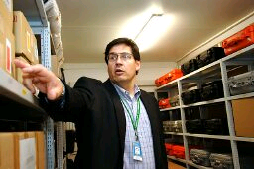
What are Safeguards?
“International accounting and verification system designed to ensure that fissile material is only used for peaceful purposes.”

Slide 5
Objectives of Safeguards
“… timely detection of diversion of significant quantities of nuclear material from peaceful nuclear activities to the manufacture of nuclear weapons or of other nuclear explosive devices of for purposes unknown, and deterrence of such diversion by risk of early detection”
  IAEA Information Circular (INFCIRC)153
  paragraph 28
  (Emphasis added)

Slide 6
Timeliness Goals and Significant Quantities
Timely Detection
Detection of diversion of significant quantities within:
- 1 month for fresh fuel containing HEU, Pu, or MOX;
- 3 months for irradiated fuel containing HEU or Pu; and
- 12 months for fresh fuel containing natural uranium,
low-enriched uranium (LEU), or thorium.
Significant quantity (SQ)
  “The approximate quantity of nuclear material … taking into account any conversion process … the possibility of manufacturing a nuclear explosive cannot be excluded.”
Notes:
6
6

Slide 7
Significant Quantities
Material SQ
Direct-use nuclear material
Puª 8 kg
U-233 8 kg
HEU (U-235 > 20%) 25 kg
Indirect-use nuclear material
U (U-235 < 20%)^{b} 75 kg
Th 20 tonnes
ª For Pu containing less than 80% Pu-238
^{b} Including natural and depleted uranium
Notes:
7
7

Slide 8

Critical masses for various fissile materials
U-233 – 16 kg
U-235 – 51 kg
Pu-239 – 10 kg
Np-237 – 73 kg
Am-241 – 60 kg
A critical mass is the smallest amount of fissile material needed for a sustained nuclear chain reaction
Values given are bare sphere critical mass with no reflector. Source = Global Fissile Material Report 2006
  According to unclassified U.S. sources, with a sophisticated design nuclear weapons can be made from as little as
  4 kg of plutonium or
  12 kg of HEU
4 kg of Pu will fit in a Coke can →

Slide 9
Safeguards Agreements
Safeguards are applied according to the terms of safeguards agreements
These agreements and much of the information related to them are confidential
Three types of safeguards agreement
  Comprehensive
  Item-Specific
  Voluntary Offer

Slide 10
Comprehensive Safeguards Agreements
Most safeguards agreements are of this type
Most common for Non-Nuclear-Weapons State Parties to the NPT
State accepts safeguards on ALL nuclear material in all peaceful activities within or under the control of the state

Slide 11
NPT Article III § 1
Each non-nuclear-weapon State Party to the Treaty undertakes to accept safeguards, as set forth in an agreement to be negotiated and concluded with the International Atomic Energy Agency in accordance with the Statute of the International Atomic Energy Agency and the Agency's safeguards system, for the exclusive purpose of verification of the fulfillment of its obligations assumed under this Treaty with a view to preventing diversion of nuclear energy from peaceful uses to nuclear weapons or other nuclear explosive devices. Procedures for the safeguards required by this Article shall be followed with respect to source or special fissionable material whether it is being produced, processed or used in any principal nuclear facility or is outside any such facility. The safeguards required by this Article shall be applied on all source or special fissionable material in all peaceful nuclear activities within the territory of such State, under its jurisdiction, or carried out under its control anywhere.

Slide 12
Item-Specific Safeguards Agreements
Item-specific safeguards cover only the material, facilities, and/or equipment specified in the agreement
Typical for Member states that are NOT States Party to the NPT
Implemented in India, Israel, and Pakistan

Slide 13
Voluntary Offer Safeguards Agreements
NPT Nuclear Weapons State Parties are NOT obligated to accept safeguards
However, all have offered to apply safeguards to some nuclear material and facilities without national security significance

Slide 14
Classical Safeguards
Traditional safeguards measures include verification activities focused on declared facilities
Required for all NPT NNWS
Referred to as “Classical” safeguards
Outlined in INFCIRC/66 and INFCIRC/153

Slide 15
Strengthened Safeguards
Discovery of Iraq’s clandestine nuclear weapons program in 1991 showed the limitations of classical safeguards
Disclosure of South Africa’s secret development of nuclear weapons that same year provided further impetus
A strengthened system of safeguards was developed to give IAEA additional tools for verification and assurance
These strengthened safeguards were developed through Program 93+2

Slide 16
The Additional Protocol
Strengthened safeguards are outlined in INFCIRC/540 (1997), known as the Model Additional Protocol
Additional Protocols are NOT required for any member state
As of June 2012, 147 Member States have signed APs
124 APs ratified and in force
Source for safeguards agreement and AP status: http://cns.miis.edu/inventory/pdfs/apmiaea.pdf
Notes:
The IAEA Additional Protocol was negotiated out of necessity after the Iraq war and the Model Additional Protocol was agreed upon in 1997.
History and significance: http://cns.miis.edu/pubs/npr/vol11/113/113hirsch.pdf
The essence of the Additional Protocol is to reshape the IAEA's safeguards regime from a quantitative system focused on accounting for known quantities of materials and monitoring declared activities to a qualitative system aimed at gathering a comprehensive picture of a state's nuclear and nuclear-related activities, including all nuclear-related imports and exports. The Additional Protocol also substantially expands the IAEA's ability to check for clandestine nuclear facilities by providing the agency with authority to visit any facility-declared or not-to investigate questions about or inconsistencies in a state's nuclear declarations. NPT states-parties are not required to adopt an Additional Protocol, although the IAEA is urging all to do so.
The model protocol outlined four key changes that must be incorporated into each NPT state-party's Additional Protocol.
· First, the amount and type of information that states will have to provide to the IAEA is greatly expanded. In addition to the current requirement for data about nuclear fuel and fuel-cycle activities, states will now have to provide an "expanded declaration" on a broad array of nuclear-related activities, such as "nuclear fuel cycle-related research and development activities-not involving nuclear materials" and "the location, operational status and the estimated annual production" of uranium mines and thorium concentration plants. (Thorium can be processed to produce fissile material, the key ingredient for nuclear weapons.) All trade in items on the Nuclear Suppliers Group (NSG) trigger list will have to be reported to the IAEA as well. The NSG is a group of 45 nuclear supplier countries that seeks to voluntarily prevent the use of peaceful nuclear technology for military purposes by restricting nuclear and nuclear-related exports.
· Second, the number and types of facilities that the IAEA will be able to inspect and monitor is substantially increased beyond the previous level. In order to resolve questions about or inconsistencies in the information a state has provided on its nuclear activities, the new inspection regime provides the IAEA with "complementary," or pre-approved, access to "[a]ny location specified by the Agency," as well as all of the facilities specified in the "expanded declaration." By negotiating an Additional Protocol, states will, in effect, guarantee the IAEA access on short notice to all of their declared-and, if necessary-undeclared facilities in order "to assure the absence of undeclared nuclear material and activities.“
· Third, the agency's ability to conduct short notice inspections is augmented by streamlining the visa process for inspectors, who are guaranteed to receive within one month's notice "appropriate multiple entry/exit" visas that are valid for at least a year.
· Fourth, the Additional Protocol provides for the IAEA's right to use environmental sampling during inspections at both declared and undeclared sites. It further permits the use of environmental sampling over a wide area rather than being confined to specific facilities.

Slide 17
The Additional Protocol
Expanded information on nuclear-related activities and facilities
Inspector access to entire nuclear fuel cycle
Short-notice inspections
Environmental sampling outside of declared facilities
Greater scope for use of open-source and third-party information

Slide 18
Overview of expanded Safeguards coverage under the Additional Protocol

Slide 19
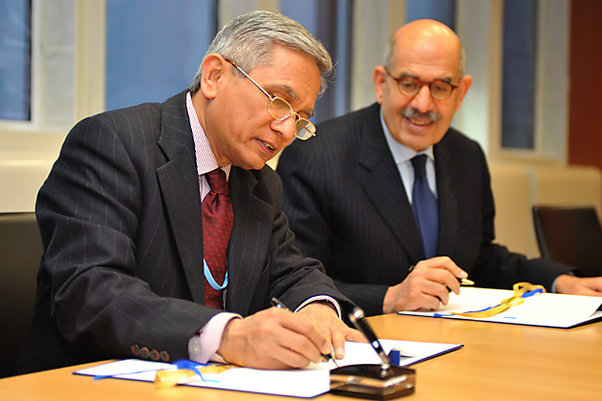
Questions on Safeguards Agreements?

Slide 20
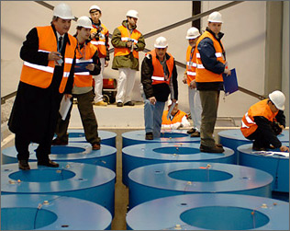
Safeguards Approaches, Practices, and Technology

Slide 21
Key Elements of Safeguards
Safeguards include three key elements:
Facility design information
Nuclear material accountancy
Containment and surveillance

Slide 22
Types of Nuclear Facilities under Safeguards
Item Facilities
nuclear material exists as
identifiable items
Bulk Handling Facilities
nuclear material exists in
form of powder, liquid, gas, etc.
Power reactors
Research reactors and
critical assemblies
Separate storage facilities
Other facilities
  (>1 kg_{eff} nuclear material)
Non-nuclear installations
Conversion plants
Fuel fabrication plants Reprocessing plants Enrichment plants
Other locations
(<1 kg_{eff} nuclear material)
http://www.iaea.org/OurWork/SV/Safeguards/sv.html
Notes:
22
22

Slide 23
Inventory and Material Balance
Increases to inventory
Beginning Physical Inventory
Ending Physical Inventory
Time
Decreases
Facility operators separate nuclear material operations into
material balance areas (MBAs):
Material Balance:
(Beginning Inventory) + (In) − (Out) = (Ending Inventory)
Any apparent difference is termed “Material Unaccounted For” (MUF):
MUF = (Beginning Inventory) + (In) − (Out) − (Ending Inventory)
Note: MUF>0 does not necessarily mean that material has been lost!
Notes:
Reveal sequence displays this flow diagram step by step
The MBA might be a vault, a room, a building, a facility… (can have nested MBAs)
Inventory increases = material received or produced
Inventory decreases = material shipped, consumed or decayed
Statistical analysis is used to determine whether or not the MUF is acceptable:
may be due to error or measurement uncertainties
may be due to material held up in a process system
may be classified as a “discrepancy”
MUF can be tracked on a cumulative basis to identify gradual diversion of small quantities of material
In the U.S., “MUF” is instead called “inventory difference”

Slide 24
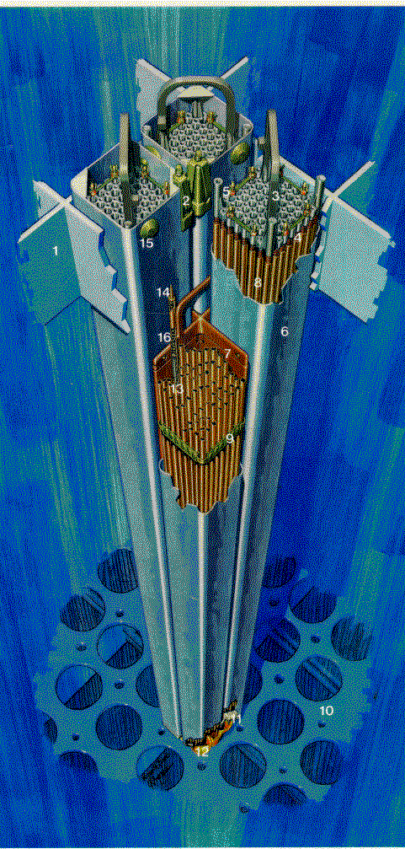
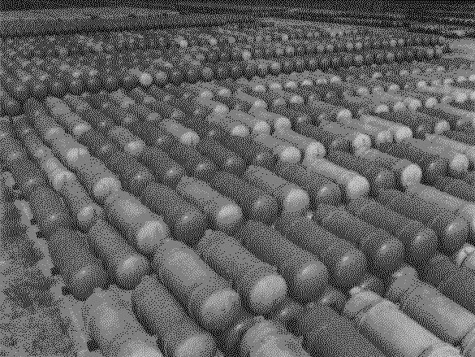
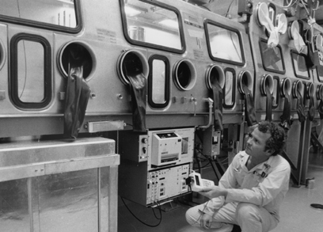
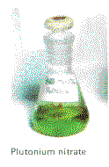
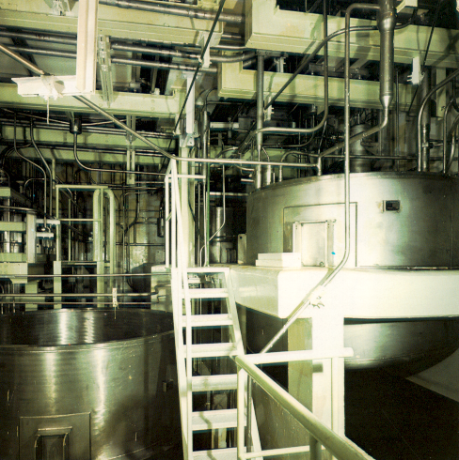
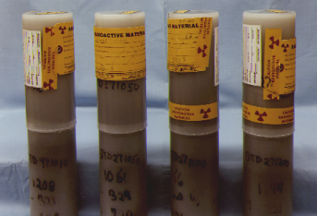
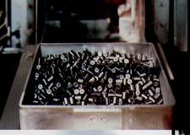
Physical and Chemical Forms of Nuclear Material
steel cylinders of uranium hexafluoride
plutonium nitrate solution
fuel pellets and assemblies for nuclear power reactors
material in process piping
oxide powder
Notes:
Examples shown here:
Physical forms:
solid (pellets, oxide fuel)
liquid (Pu nitrate solution from a spent fuel reprocessing stream)
gas (UF6 at room temperature & pressure)
—but it’s a solid in the cylinders shown here because it’s under pressure
Chemical forms:
oxide
pure metal
nitrate, hexafluoride
Containment:
box (of pellets)
alloy cladding (fuel pins)
glove box (for remote handling)
sealed cylinders
process piping

Slide 25

Nuclear materials emit penetrating neutron and/or gamma radiation, which can be monitored readily
betas
gammas
The type and intensity of the radiation can reveal precisely what nuclear material is present. It is a “signature” of the nuclear material.
Emission is affected by other elements present.
The time distribution of neutrons can also convey information.
nuclear material
neutrons
fission products
alphas
heat
container
A wide variety of technical measures exists to detect, identify and assay nuclear and fissile materials.
Notes:
Radiation detection can provide both qualitative and quantitative information:
Is something there?
What is it?
With certain instruments, radiation detection can further reveal how much material is present.

Slide 26
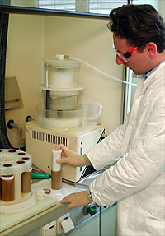
Sampling for Inventory Verification
IAEA samples nuclear materials in processing facilities to verify materials and operations
Samples are analyzed in the Safeguards Analytical Laboratory (SAL) at Seibersdorf, Austria
A network of analytical laboratories in the U.S. and other States provides additional capacity and quality control
Notes:
26
26

Slide 27

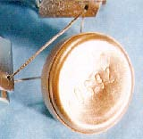
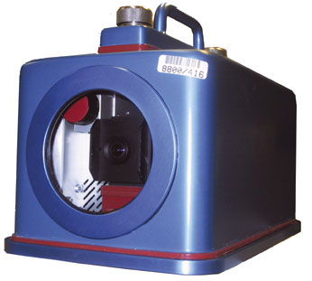
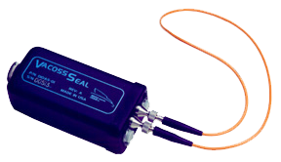
Containment & Surveillance (C/S)
Containment and surveillance detects activities that could alter composition or quantities of nuclear material
Provides “continuity of knowledge” between inspections
Containment: loop seals
Surveillance: digital video camera
Notes:
These technologies stay at the facility between inspections
Many versions of loop seals exist. Shown here, clockwise from upper left, are
Cobra: passive, fiber-optic design
e-cup: passive, metal wire
Vacoss: active, fiber-optic
Video surveillance is now mostly digital (DCM-14 shown)
The enclosure around the camera illustrates tamper indication: the need to ensure that the monitoring system itself is secure

Slide 28
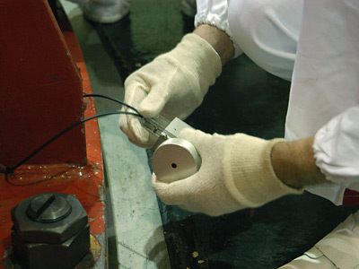
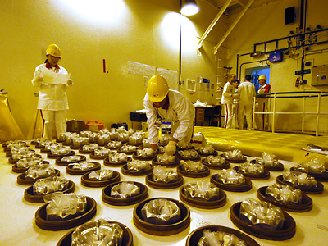
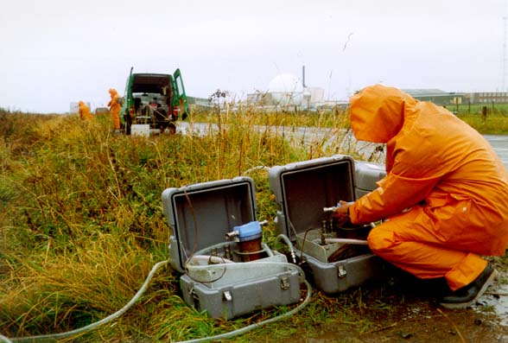
Tools for Strengthened Safeguards
COBRA Seals
Physical Inventory Exercise
Environmental Sampling
Notes:
Scenes from a training exercise. The COBRA Seal System in the photograph is a fibre optic general purpose seal. The seal is inserted into a verification assembly that records a reference image of the seal signature pattern. The aim of the comprehensive inspection exercise was to train IAEA Safeguard inspectors in real-life scenarios. The exercise took place at Slovenia's Mochovce Nuclear Power Plant (NPP) on 17-21 January 2005. (Mochovce, Nuclear Power Plant, Levice, Slovakia, January 17-21, 2005)
Ocean water sampling off the coast of Scotland during safeguards environmental monitoring trials. (Dounreay, Scotland, 1993)
Scenes from a verification training exercise. IAEA Safeguard inspectors doing a physical inventory of fuel assemblies stored on a fresh fuel rack. The aim of the comprehensive inspection exercise was to train IAEA Safeguard inspectors in real-life scenarios. The exercise took place at Slovenia's Mochovce Nuclear Power Plant (NPP) on 17-21 January 2005. (Mochovce, Nuclear Power Plant, Levice, Slovakia, January 17-21, 2005)

Slide 29
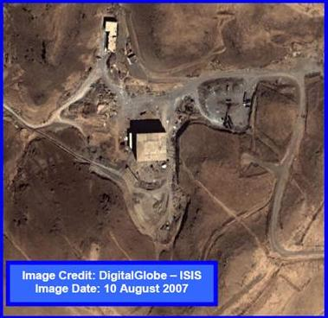
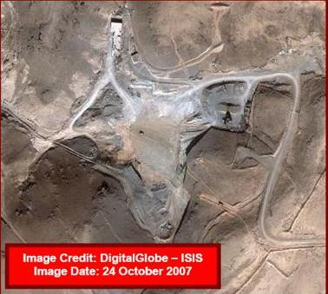
Tools for Strengthened Safeguards
Open-source image of Al-Kibar Reactor Before Israeli Strike
Open-source image of Al-Kibar Reactor After Israeli Strike

Slide 30
Summing it all up
International nuclear safeguards are a fundamental pillar of the non-proliferation regime. They continue to play an important role in curbing the spread of nuclear weapons.
Safeguards are designed and carried out according to safeguards agreements
Key elements of safeguards include facility design information, nuclear material accountancy, and containment and surveillance
A variety of technical tools can be used to provide accountancy and continuity of knowledge on nuclear materials

Slide 31
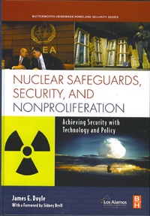
Recommended Reading
James E. Doyle, ed., Nuclear Safeguards, Security, and Nonproliferation (New York: Butterworth-Heinemann, 2008)

Slide 32
Links for more information
IAEA Education & Training: http://www.iaea.org/Publications/Training/index.html
CNS/NTI Nuclear Safeguards Study Guide: http://www.nti.org/h_learnmore/h5_study_guides.html
World Nuclear Association:
http://www.world-nuclear.org/education/nfc.htm
NSSPI Nuclear Safeguards Education Portal: http://nsspi.tamu.edu/NSEP/

Slide 33
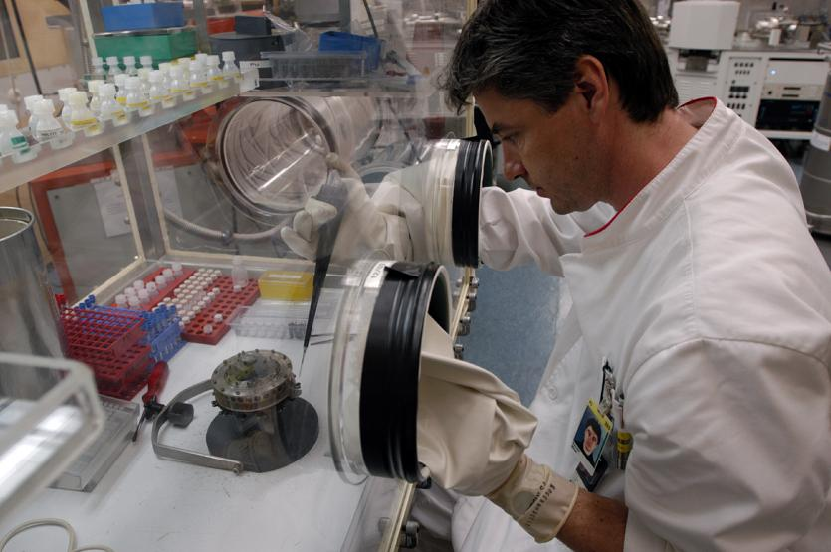
Questions?

Slide 34
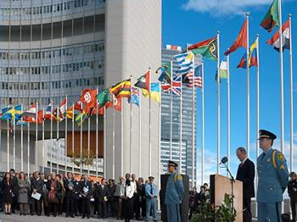
Thanks!
Fred Wehling, Ph.D.
James Martin Center for Nonproliferation Studies
Monterey Institute of International Studies
460 Pierce Street
Monterey, CA 93940 USA
Phone: +1-831-647-3084
Fax: +1-831-647-3519
fwehling@miis.edu
http://cns.miis.edu

